Slide 1
Solution Sets Of Linear Systems
Prabhat Ale
22

Slide 2
Linear System & Its Types
Linear systems typically refer to systems of linear equations. In mathematics, a system of linear equations consists of two or more equations involving two or more variables. Each equation in the system is linear, meaning that the highest power of any variable is 1.
Types:
Consistent Linear Systems
Inconsistent Linear Systems
Overdetermined Linear Systems
Underdetermined Linear System
Homogeneous Linear Systems
Non Homogeneous Linear Systems

Slide 3
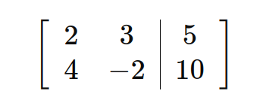
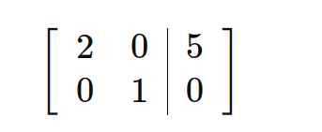
Consistent Linear Systems
A linear system is consistent if it has at least one solution.
Example:
Solving them we get,

Slide 4
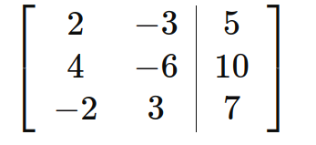
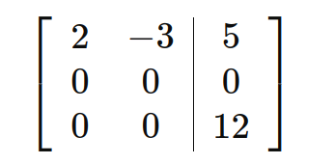
Inconsistent Linear Systems
A linear system is inconsistent if it has no solution.
Example:
Solving them we get,

Slide 5
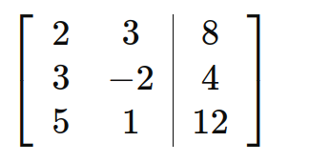
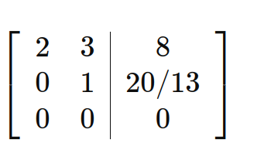
OverDetermined Linear Systems
These systems have more equations than unknowns. Overdetermined systems often arise in real-world applications.
Example:
Solving this we get,

Slide 6
UnDetermined Linear Systems
These systems have fewer equations than unknowns. Underdetermined systems typically have infinitely many solutions.
Examples:
2x + 3y - z = 5
4x - 6y + 2z = 10

Slide 7
Homogeneous Linear Systems
A system of linear equations is said to be homogeneous if it can be written in the form Ax = 0.
where A is an m*n matrix and 0 is the zero vector in Rⁿ.
Such a system Ax = 0 always has at least one solution, namely x = 0 (the zero vector in Rⁿ)
The solution is usually called the trivial solution.
The homogeneous equation Ax=0, the important question is whether there exists a non-trivial solution that is, a non zero vector x that satisfies Ax = 0.

Slide 8
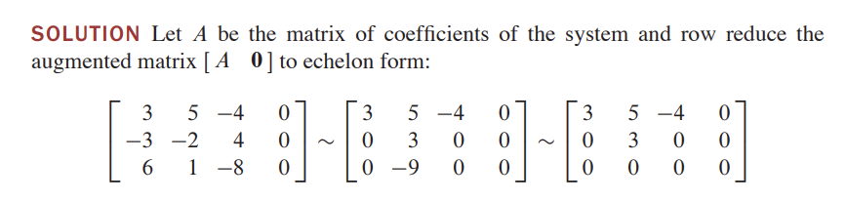
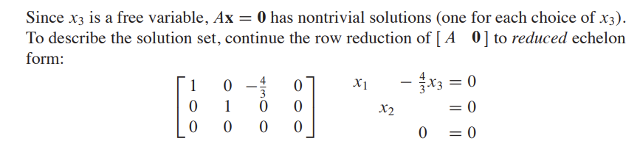
Example1: Homogeneous Equation
3x1 + 5x2 - 4x3 = 0
-3x1 - 2x2 + 4x3 = 0
6x1 + x2 - 8x3 = 0

Slide 9
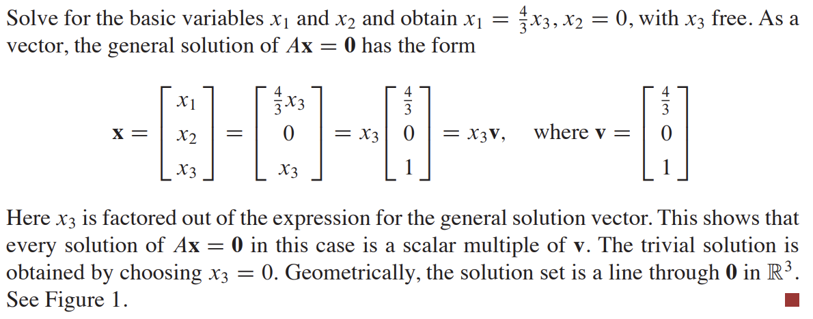
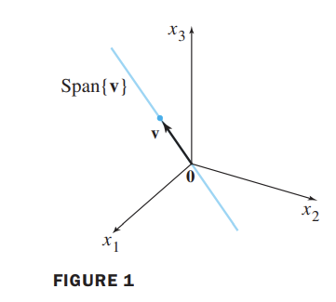
Example1: Homogeneous Equation

Slide 10
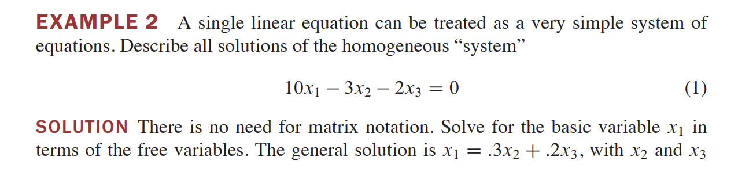
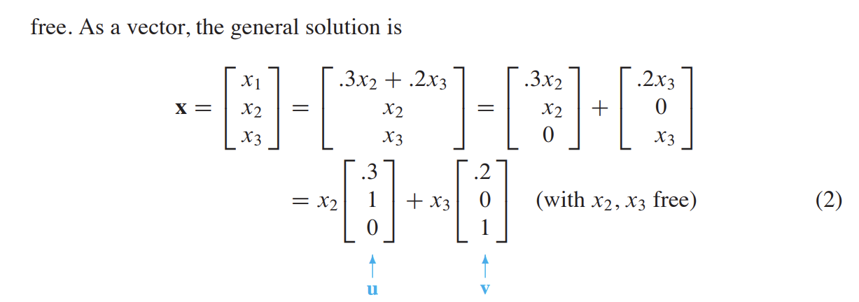

Slide 11
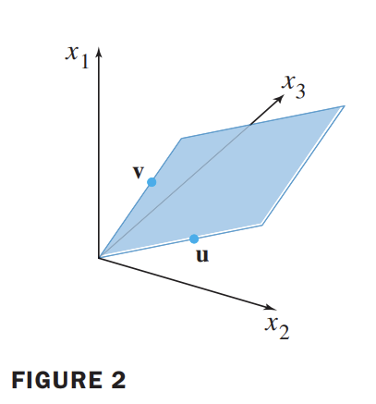
Geometrical Interpretation Of Figure 2
Examples 1 and 2, illustrate the fact that the solution set of a homogeneous equation Ax = 0 can always be expressed explicitly as span for suitable vectors.
If the equation Ax = 0 has only one free variable, the solution set is a line through the origin, as in Figure 1.
If the equation Ax = 0 has two or more free variables, then the solution set is a plane passing through the origin, as in Figure 2.

Slide 12
Parametric Vector Form
Equation (2) presents a parametric vector equation of the plane, often expressed as x = su + tv, where s and t vary over all real numbers.
Example 1 illustrates a similar approach, where the equation x = x3v (x3 unrestricted) or x = tv (with t ∈ ℝ) represents a parametric vector equation for a line.
When solution sets are described explicitly using vectors, as shown in Examples 1 and 2, they're referred to as being in parametric vector form.

Slide 13
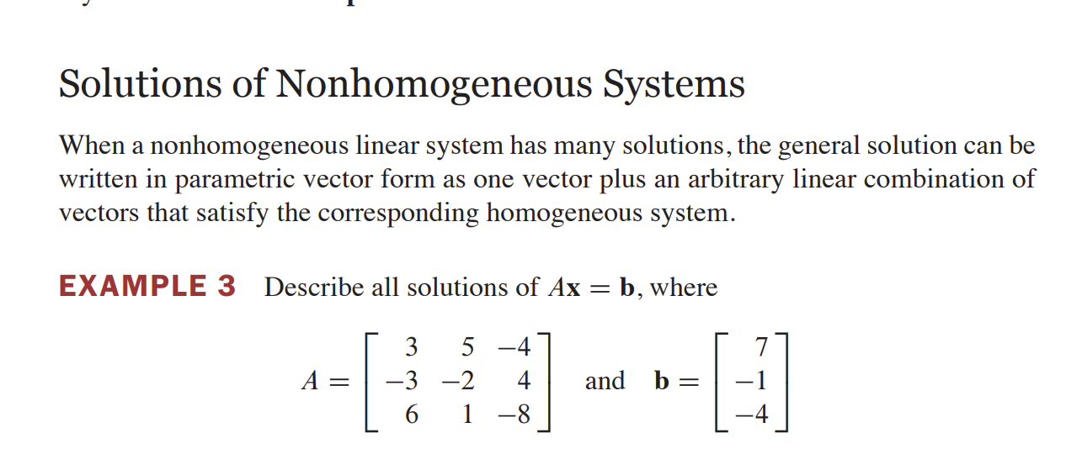
Non Homogeneous Systems

Slide 14
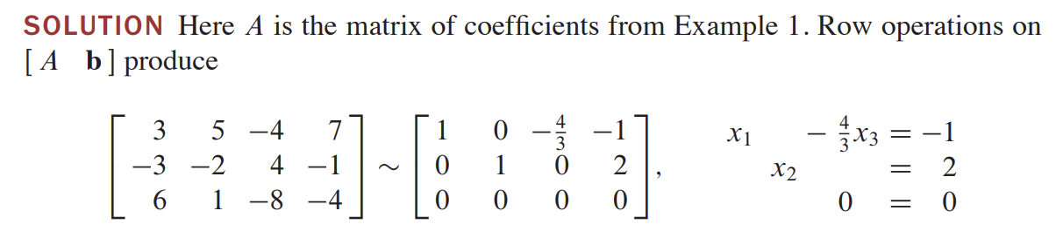
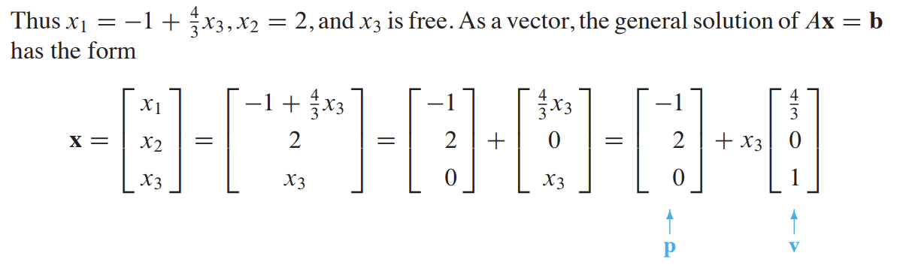

Slide 15
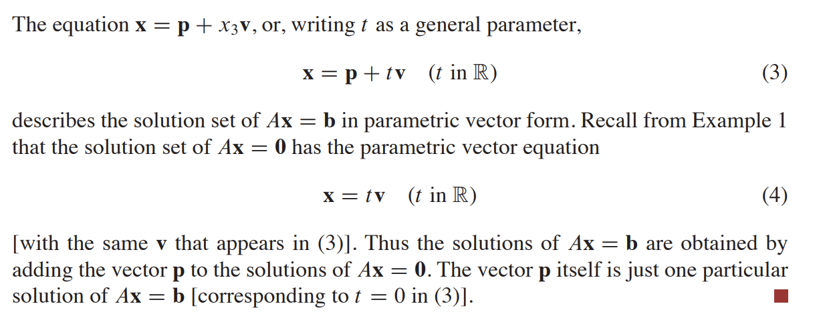
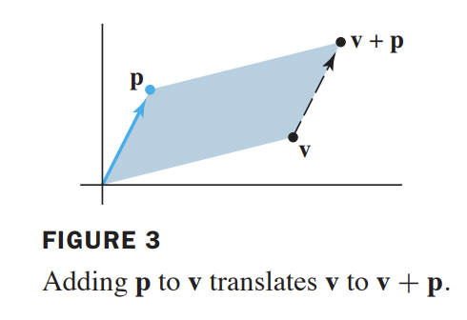

Slide 16
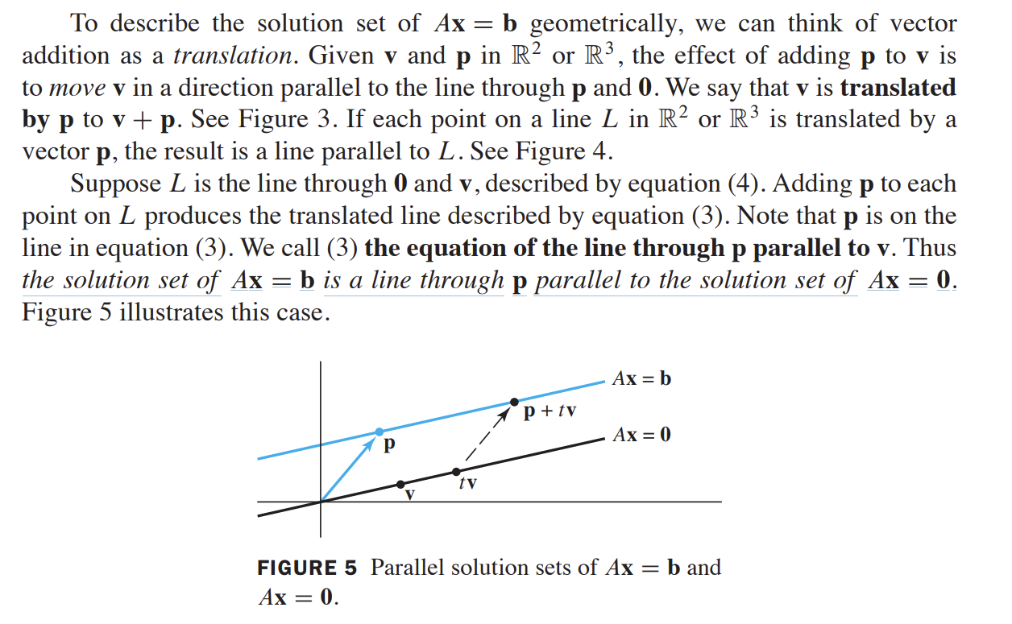

Slide 17
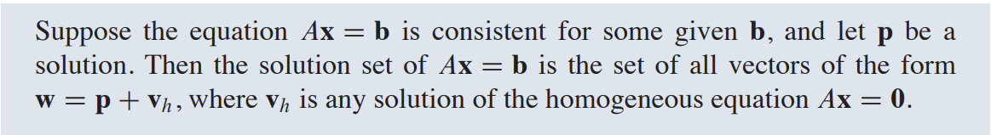
THEOREM

Slide 18
Conclusion
A homogeneous system Ax = 0 always has at least one solution, namely x = 0 (the zero vector in Rⁿ). Such solution is usually called the trivial solution.
If the equation Ax = 0 has only one free variable, the solution set is a line through the origin, as in Figure 1. If the equation Ax = 0 has two or more free variables, then the solution set is a plane passing through the origin, as in Figure 2.
For non homogeneous linear system with equation Ax=b, the solution set can often be expressed as the sum of a particular solution to the non-homogeneous system and the general solution to the corresponding homogeneous system Ax=0 such that they are parallel to each other.

Slide 19


